Slide 1
Cover letter

Slide 2
Cover letter
A cover letter is a document you send with your CV (traditionally as the front cover).
However, it differs from a CV in that instead of being a written overview of your skills and experience, it’s specifically written with the job you’re applying for in mind – allowing you to highlight certain areas you think would make you right for the role.

Slide 3
Why is a cover letter important?
To put it simply, your cover letter is the easiest and most effective way to stand out from the crowd.
It brings a something extra to the table when you apply for a job – the employer will learn more about you, your personality, what you actually want from the job and gain insight as to why you’re applying.
And, as your CV is supposed to be short and sweet, your cover letter is the perfect way to elaborate on your achievements.

Slide 4
Purpose of a cover letter
Each time you mail your resume/CV always include a cover letter stating your interest in the firm.
The letter, however, should not duplicate resume information.
It should briefly highlight the skills or positions you held previously that are appropriate to the position you seek.
It also can be used to add additional information that you think is important to the employer.

Slide 5
Your cover letter should:
Personalize Letter for Each Role For each role that you apply to, whether within the same company or with different companies, personalize your letter to the advertised role. Your cover letter should not be generic. Not only include your strengths and skills, but also explain why you’re the perfect candidate for the job position. This means that for each job that you apply to, you have to write a new cover letter. The company wants to believe that you took the time to read about and understand the role. It may be tedious and time consuming to write multiple letters, but it will be worth it in the end.
Include Contact Information Ensure that your cover letter has the name of the individual hiring a candidate for the role. It could be a department manager or the HR lead. In any case, make sure you have information on who the hiring manager is by either checking the company’s website or calling in. This way, you can open the letter with a proper greeting. Be sure to add your contact information on your cover letter, even though it may already be included in your resume.

Slide 6
Use Simple Words You want to clearly communicate your worth and why you should be considered for the job position that you’re applying to. Using complex words and sentences would most certainly fail to convey your intentions with the company. If the manager or HR representative reading the letter cannot decipher your ‘big’ words, s/he will probably not bother with the rest of your application.
Quantify Accomplishments Remember that the cover letter should not rehash your resume, rather it should provide more information on areas on your resume that are relevant to the job that you are applying for. For these areas, be sure to quantify your accomplishments. For example, while your resume may state that you used a marketing analytics tool to drive more clients to sign up for your employer’s services, a cover letter will expatiate on this by adding that your strategy brought in an additional 200 clients monthly and increased revenue to $10,000. This way you can set yourself apart from the other job candidates with vague accomplishments.
Proofread After you’ve written the letter, proofread it multiple times to ensure that there are no typos or grammatical errors. Also, ask a trustworthy person to proofread as well and recommend any areas that should be added or excluded from the letter.

Slide 7
Elements of a Cover Letter
Opening. Explain why you are writing. State the position you are seeking and the source of the job opening (e.g., newspaper ad, professional organization, colleague).
Main body. Highlight your job qualifications and link them to the firm's needs. Show that you know something about the firm and are interested in the firm's products or services. Explain why you chose this company. For example, you know someone who works there, you use their products or you heard about their good reputation.
Closing. Request an interview. Suggest a specific date and time. For example: "I'll try to contact you on Monday morning to see when you might be able to meet with me."
Be sure to include your name, address and telephone number.
Thank the employer for his or her time and effort.

Slide 8
Tips on Preparing a Cover Letter
Write an individualized cover letter for each job employer.
Address the letter to the person you want to contact, preferably the one doing the hiring.
Use correct grammar, spelling and punctuation.
Convey personal warmth and enthusiasm.
Keep your letter short and to the point.

Slide 9
Joseph Q. Applicant 123 Main Street Anytown, CA 12345 555-212-1234 josephq@email.com
September 1, 2018
Jane Smith Director, Human Resources Fit Living 123 Business Rd. Business City, NY 54321
Dear Ms. Smith:
I’m writing to apply for the position of Social Media Manager for Fit Living, as advertised on your website careers page. I have three years of experience as a Social Media Assistant for Young Living, and I believe I am ready to move up to the manager position.
In your job posting, you mention that you want to hire a Social Media Manager who understands Internet and social media trends. During my time at Young Living, I was given the responsibility of increasing follower numbers on Instagram. I explained to my manager that I would be happy to do so, and that I would also work hard to increase follower participation, because engagement has become an important metric.
Within six months, I increased our followers by over 50 percent and increased engagement by 400 percent. I’m very proud of that accomplishment. Currently, I’m working to build a following with the best influencers in our niche.
When I saw the job opening, I knew it was the perfect opportunity to offer you both my social media marketing skills and people skills. I’ve included my resume so you can learn more about my educational background and all of my work experience.Thank you for your time and consideration.
Please feel free to email me or call my cell phone at 555-555-5555. I hope to hear from you soon.
Sincerely,
Your Signature (hard copy letter)
Joseph Q. Applicant

Slide 10
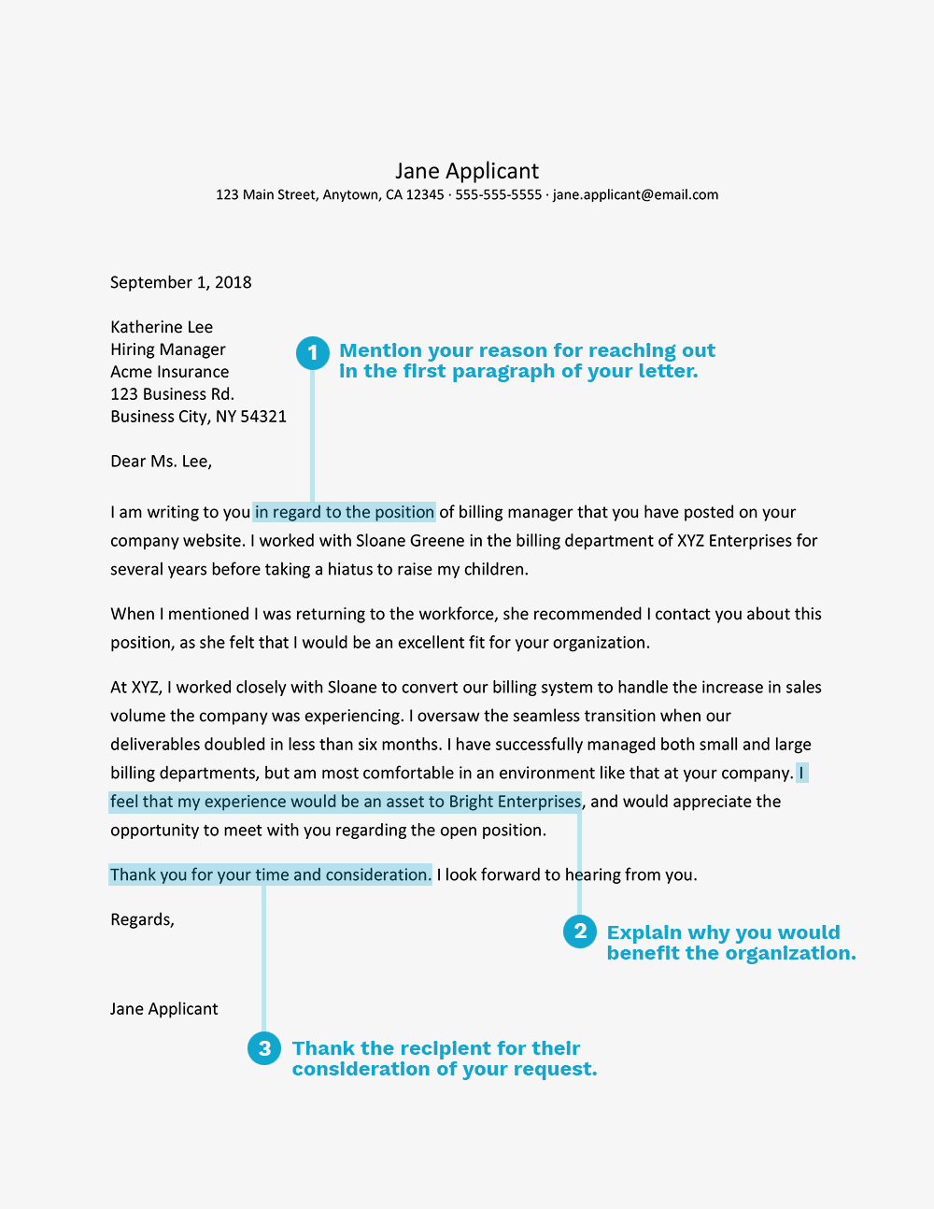

Slide 11
Subject: Editorial Assistant Position - Jane Jones
Dear [Name of Hiring Manager or “Hiring Manager”]:
I would like to express my deep interest in entering a position as an editorial assistant for your publishing company.
As a recent graduate with writing, editing, and administrative experience, I believe I am a strong candidate for a position at the 123 Publishing Company.
You specify that you are looking for someone with strong writing skills. As an English major at XYZ University, a writing tutor, and an editorial intern for both a government magazine and a college marketing office, I have become a skilled writer with a variety of publication experience.
My maturity, practical experience, attention to detail, and eagerness to enter the publishing business will make me an excellent editorial assistant. I would love to begin my career with your company and am confident that I would be a beneficial addition to the 123 Publishing Company.
I have attached my resume to this email and will call within the next week to see if we might arrange a time to speak together.
Thank you so much for your time and consideration.
Sincerely,
Jane Jones 111 Main Street Town, NY 11111 Email: janejones@gmail.com Cell: (555) 555-5555 LinkedIn: linkedin.com/in/janejones

Slide 12
